Slide 1
Denominators Team

Slide 2

Denominators Team
Home > HQ > Interagency Collaborative for Program Involvement (ICPI) > General> Clusters >
Team Lead: Roma Bhatkoti, Joshua Davis
ICPI Lead: Jasmine Buttolph
Members: JP Abellera, Travis Lim, Ray Shiraishi, Mohammed Mujawar, James Houston, Ian Fellows, Randy Yee, Anubhuti Mishra, Aaron Chafetz, Noah Bartlett, Kim Marsh, Ian Wanyeki, Jeff Eaton, Oliver Stevens, Athena Pantazis, Yaa Obeng-Aduasare, Jasmine Buttolph, Shaylee Mehta, Scott Jackson, Parviez Hosseini
Week of July 22nd , 2019
Background Denominators workstream started few years ago - 2017 ish Denominators workstream (now called Denominators Team) revived – 2019 CDC Lead – Roma Bhatkoti USAID Lead – Joshua Davis

Slide 3
Denominators Team
Home > HQ > Interagency Collaborative for Program Involvement (ICPI) > General> Clusters >
Team Lead: Roma Bhatkoti, Joshua Davis
ICPI Lead: Jasmine Buttolph
Members: JP Abellera, Travis Lim, Ray Shiraishi, Mohammed Mujawar, James Houston, Ian Fellows, Randy Yee, Anubhuti Mishra, Aaron Chafetz, Noah Bartlett, Kim Marsh, Ian Wanyeki, Jeff Eaton, Oliver Stevens, Athena Pantazis, Yaa Obeng-Aduasare, Jasmine Buttolph, Shaylee Mehta, Scott Jackson, Parviez Hosseini
Week of July 22nd , 2019 Participating Organizations CDC USAID US Census DoD UNAIDS PeaceCorps State Department UNAIDS Reference Group on Estimates, Modelling and Projections

Slide 4
Denominators Team
Home > HQ > Interagency Collaborative for Program Involvement (ICPI) > General> Clusters >
Team Lead: Roma Bhatkoti, Joshua Davis
ICPI Lead: Jasmine Buttolph
Members: JP Abellera, Travis Lim, Ray Shiraishi, Mohammed Mujawar, James Houston, Ian Fellows, Randy Yee, Anubhuti Mishra, Aaron Chafetz, Noah Bartlett, Kim Marsh, Ian Wanyeki, Jeff Eaton, Oliver Stevens, Athena Pantazis, Yaa Obeng-Aduasare, Jasmine Buttolph, Shaylee Mehta, Scott Jackson, Parviez Hosseini
Week of July 22nd , 2019
Stakeholders CDC - Laura Porter UNAIDS - Mary Mahy S/GAC - Irum F. Zaidi USAID - Rachel Lucas

Slide 5
Denominators Team
Home > HQ > Interagency Collaborative for Program Involvement (ICPI) > General> Clusters >
Team Lead: Roma Bhatkoti, Joshua Davis
ICPI Lead: Jasmine Buttolph
Members: JP Abellera, Travis Lim, Ray Shiraishi, Mohammed Mujawar, James Houston, Ian Fellows, Randy Yee, Anubhuti Mishra, Aaron Chafetz, Noah Bartlett, Kim Marsh, Ian Wanyeki, Jeff Eaton, Oliver Stevens, Athena Pantazis, Yaa Obeng-Aduasare, Jasmine Buttolph, Shaylee Mehta, Scott Jackson, Parviez Hosseini
Week of July 22nd , 2019 Objective 1 Harmonizing accessibility To provide leadership in the development of a transparent, appropriate and shareable platform for tools and estimates where analysts, countries and decision makers can easily gain new insights into PEPFAR data using state of the art analytic tools and access important data in time to impact program planning and monitoring and with lowest possible level of effort (LOE).

Slide 6
Denominators Team
Home > HQ > Interagency Collaborative for Program Involvement (ICPI) > General> Clusters >
Team Lead: Roma Bhatkoti, Joshua Davis
ICPI Lead: Jasmine Buttolph
Members: JP Abellera, Travis Lim, Ray Shiraishi, Mohammed Mujawar, James Houston, Ian Fellows, Randy Yee, Anubhuti Mishra, Aaron Chafetz, Noah Bartlett, Kim Marsh, Ian Wanyeki, Jeff Eaton, Oliver Stevens, Athena Pantazis, Yaa Obeng-Aduasare, Jasmine Buttolph, Shaylee Mehta, Scott Jackson, Parviez Hosseini
Week of July 22nd , 2019 Objective 1 Objective 1 is supported by the following goals - Enhance data accessibility at the time of decision making. Enhance data accessibility to stakeholders. Enhance data accessibility as both a WIP (work in progress) and final product. Enhance data accessibility from multiple sources. Enhance documentation and transparency of methodology for estimation of both WIP and final product data. Streamline processes for selecting appropriate platform for data and tools.

Slide 7
Denominators Team
Home > HQ > Interagency Collaborative for Program Involvement (ICPI) > General> Clusters >
Team Lead: Roma Bhatkoti, Joshua Davis
ICPI Lead: Jasmine Buttolph
Members: JP Abellera, Travis Lim, Ray Shiraishi, Mohammed Mujawar, James Houston, Ian Fellows, Randy Yee, Anubhuti Mishra, Aaron Chafetz, Noah Bartlett, Kim Marsh, Ian Wanyeki, Jeff Eaton, Oliver Stevens, Athena Pantazis, Yaa Obeng-Aduasare, Jasmine Buttolph, Shaylee Mehta, Scott Jackson, Parviez Hosseini
Week of July 22nd , 2019 Objective 2 Platform for sharing and developing forward thinking methodologies To provide a platform to connect different programmatic ICPI clusters and external stakeholders (field teams, epidemic control teams (ECTs), ST3 (short term task teams) and implementing agency and OGAC leadership to explore possibilities of collaboration and improvements to existing methodologies, To provide a convening platform for forward thinking methodologies; and To pro-actively work on innovative and rigorous methodologies, targeting general population, priority population, key populations at sub-national levels and finer age and sex bands.

Slide 8
Denominators Team
Home > HQ > Interagency Collaborative for Program Involvement (ICPI) > General> Clusters >
Team Lead: Roma Bhatkoti, Joshua Davis
ICPI Lead: Jasmine Buttolph
Members: JP Abellera, Travis Lim, Ray Shiraishi, Mohammed Mujawar, James Houston, Ian Fellows, Randy Yee, Anubhuti Mishra, Aaron Chafetz, Noah Bartlett, Kim Marsh, Ian Wanyeki, Jeff Eaton, Oliver Stevens, Athena Pantazis, Yaa Obeng-Aduasare, Jasmine Buttolph, Shaylee Mehta, Scott Jackson, Parviez Hosseini
Week of July 22nd , 2019 Objective 2 Objective 2 is supported by the following goals - Connect different clusters and external stakeholders where appropriate to ensure timely sharing of estimates, methods, data and tools. Connect PEPFAR OUs to tools and methods developed by clusters and technical workgroups. Explore cutting edge methodologies (including but not limited to machine learning, dynamic modeling, network analysis) to develop epidemiological data and estimates for general population, key populations and priority populations—at subnational levels (where applicable) and finer age and sex bands (where applicable). Develop prototypes for innovative methods to share with the stakeholders and iteratively convert successful prototypes into products. Develop training materials and other resources to allow analysts in program clusters, monitoring and evaluation teams at agencies, and field teams to incorporate products into routine work when possible.

Slide 9
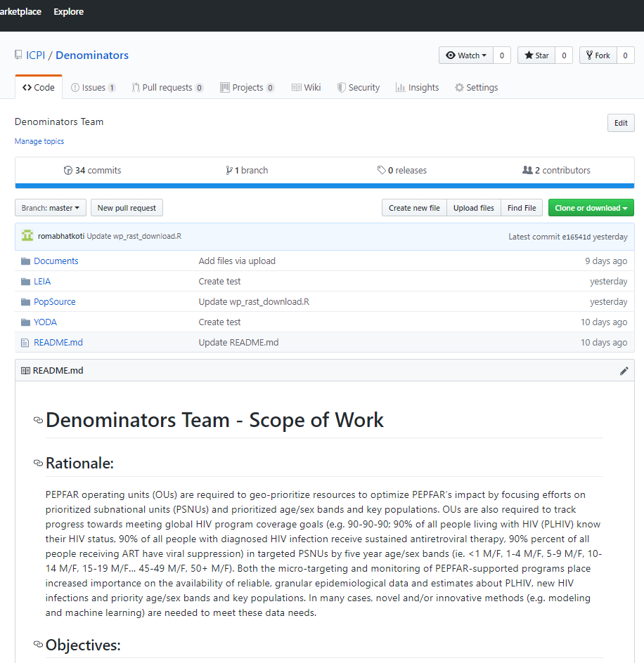
Denominators Team
Home > HQ > Interagency Collaborative for Program Involvement (ICPI) > General> Clusters >
Team Lead: Roma Bhatkoti, Joshua Davis
ICPI Lead: Jasmine Buttolph
Members: JP Abellera, Travis Lim, Ray Shiraishi, Mohammed Mujawar, James Houston, Ian Fellows, Randy Yee, Anubhuti Mishra, Aaron Chafetz, Noah Bartlett, Kim Marsh, Ian Wanyeki, Jeff Eaton, Oliver Stevens, Athena Pantazis, Yaa Obeng-Aduasare, Jasmine Buttolph, Shaylee Mehta, Scott Jackson, Parviez Hosseini
Week of July 22nd , 2019
Logistics – Denominators Github Repository https://github.com/ICPI/Denominators

Slide 10
Denominators Team
Home > HQ > Interagency Collaborative for Program Involvement (ICPI) > General> Clusters >
Team Lead: Roma Bhatkoti, Joshua Davis
ICPI Lead: Jasmine Buttolph
Members: JP Abellera, Travis Lim, Ray Shiraishi, Mohammed Mujawar, James Houston, Ian Fellows, Randy Yee, Anubhuti Mishra, Aaron Chafetz, Noah Bartlett, Kim Marsh, Ian Wanyeki, Jeff Eaton, Oliver Stevens, Athena Pantazis, Yaa Obeng-Aduasare, Jasmine Buttolph, Shaylee Mehta, Scott Jackson, Parviez Hosseini
Week of July 22nd , 2019
Project 1 - YODA

Slide 11
Denominators Team
Home > HQ > Interagency Collaborative for Program Involvement (ICPI) > General> Clusters >
Team Lead: Roma Bhatkoti, Joshua Davis
ICPI Lead: Jasmine Buttolph
Members: JP Abellera, Travis Lim, Ray Shiraishi, Mohammed Mujawar, James Houston, Ian Fellows, Randy Yee, Anubhuti Mishra, Aaron Chafetz, Noah Bartlett, Kim Marsh, Ian Wanyeki, Jeff Eaton, Oliver Stevens, Athena Pantazis, Yaa Obeng-Aduasare, Jasmine Buttolph, Shaylee Mehta, Scott Jackson, Parviez Hosseini
Week of July 22nd , 2019
Ongoing Project 1 - Yield Optimization Data Algorithm (YODA) Granular Targeted HIV Testing Using Machine Learning YODA: Goals If treatment is prevention and testing leads to treatment, then increasing yield rates is of paramount importance in preventing infections. Many people are being tested, but are we targeting the right people? How would we know? Can machine learning help target positive individuals for testing by setting testing targets at a granular level? Can we identify high performing sites and replicate their methods? Can we identify low performing sites and stage interventions?

Slide 12
Denominators Team
Home > HQ > Interagency Collaborative for Program Involvement (ICPI) > General> Clusters >
Team Lead: Roma Bhatkoti, Joshua Davis
ICPI Lead: Jasmine Buttolph
Members: JP Abellera, Travis Lim, Ray Shiraishi, Mohammed Mujawar, James Houston, Ian Fellows, Randy Yee, Anubhuti Mishra, Aaron Chafetz, Noah Bartlett, Kim Marsh, Ian Wanyeki, Jeff Eaton, Oliver Stevens, Athena Pantazis, Yaa Obeng-Aduasare, Jasmine Buttolph, Shaylee Mehta, Scott Jackson, Parviez Hosseini
Week of July 22nd , 2019
Ongoing Project 1 - Yield Optimization Data Algorithm (YODA) YODA: Model YODA redistributes testing numbers among sites to maximize yield. Actionable table of recommended # of tests by site/modality/partner/age/sex.

Slide 13
Denominators Team
Home > HQ > Interagency Collaborative for Program Involvement (ICPI) > General> Clusters >
Team Lead: Roma Bhatkoti, Joshua Davis
ICPI Lead: Jasmine Buttolph
Members: JP Abellera, Travis Lim, Ray Shiraishi, Mohammed Mujawar, James Houston, Ian Fellows, Randy Yee, Anubhuti Mishra, Aaron Chafetz, Noah Bartlett, Kim Marsh, Ian Wanyeki, Jeff Eaton, Oliver Stevens, Athena Pantazis, Yaa Obeng-Aduasare, Jasmine Buttolph, Shaylee Mehta, Scott Jackson, Parviez Hosseini
Week of July 22nd , 2019
Project 2 - Estimating Male Circumcision Coverage

Slide 14
Denominators Team
Home > HQ > Interagency Collaborative for Program Involvement (ICPI) > General> Clusters >
Team Lead: Roma Bhatkoti, Joshua Davis
ICPI Lead: Jasmine Buttolph
Members: JP Abellera, Travis Lim, Ray Shiraishi, Mohammed Mujawar, James Houston, Ian Fellows, Randy Yee, Anubhuti Mishra, Aaron Chafetz, Noah Bartlett, Kim Marsh, Ian Wanyeki, Jeff Eaton, Oliver Stevens, Athena Pantazis, Yaa Obeng-Aduasare, Jasmine Buttolph, Shaylee Mehta, Scott Jackson, Parviez Hosseini
Week of July 22nd , 2019
Ongoing Project 2 – Estimating Male Circumcision Coverage Goal - To develop a tool to summarizes national and sub-national coverage of medical circumcision (e.g., proportion of men medically circumcised) across 15 priority countries for VMMC. This tool should be interagency, housed in OGAC, and intrinsically harmonized with related entities like MER VMMC indicators and datapack fields. Output from the tool should be harmonization with the VMMC achievement data annually released worldwide by WHO, which is the global standard reference. Current Tool - DMPPT2 tool (developed by Avenir Health) - output doesn’t match PHIA Proposed Solution - Use Small Area Estimation methodology (currently used for subnational estimation of HIV prevalence and people living with HIV/AIDS) for estimating VMMC at subnational level.

Slide 15
Denominators Team
Home > HQ > Interagency Collaborative for Program Involvement (ICPI) > General> Clusters >
Team Lead: Roma Bhatkoti, Joshua Davis
ICPI Lead: Jasmine Buttolph
Members: JP Abellera, Travis Lim, Ray Shiraishi, Mohammed Mujawar, James Houston, Ian Fellows, Randy Yee, Anubhuti Mishra, Aaron Chafetz, Noah Bartlett, Kim Marsh, Ian Wanyeki, Jeff Eaton, Oliver Stevens, Athena Pantazis, Yaa Obeng-Aduasare, Jasmine Buttolph, Shaylee Mehta, Scott Jackson, Parviez Hosseini
Week of July 22nd , 2019
Project 3 - LEIA

Slide 16
Denominators Team
Home > HQ > Interagency Collaborative for Program Involvement (ICPI) > General> Clusters >
Team Lead: Roma Bhatkoti, Joshua Davis
ICPI Lead: Jasmine Buttolph
Members: JP Abellera, Travis Lim, Ray Shiraishi, Mohammed Mujawar, James Houston, Ian Fellows, Randy Yee, Anubhuti Mishra, Aaron Chafetz, Noah Bartlett, Kim Marsh, Ian Wanyeki, Jeff Eaton, Oliver Stevens, Athena Pantazis, Yaa Obeng-Aduasare, Jasmine Buttolph, Shaylee Mehta, Scott Jackson, Parviez Hosseini
Week of July 22nd , 2019
Ongoing Project 3 – Linkage event identification algorithm (LEIA) Agent-based spatial method to analyze patient flow among HIV testing and treatment sites To assess PLHIV movement across sites using testing numbers HTS_TST_POS, treatment numbers, and the simulated spatial location of patients in relation to the treatment facilities within their spatial neighborhood. To identify where newly identified HIV positive persons are linked to treatment. To identify sites (facilities or commune) with the largest linkage gaps (i.e., newly identified HIV positive persons who are not linked to care) To identify potential bottlenecks to treatment by analyzing patient flow from sites (facilities or commune) with the largest treatment gaps to neighboring sites.

Slide 17
Denominators Team
Home > HQ > Interagency Collaborative for Program Involvement (ICPI) > General> Clusters >
Team Lead: Roma Bhatkoti, Joshua Davis
ICPI Lead: Jasmine Buttolph
Members: JP Abellera, Travis Lim, Ray Shiraishi, Mohammed Mujawar, James Houston, Ian Fellows, Randy Yee, Anubhuti Mishra, Aaron Chafetz, Noah Bartlett, Kim Marsh, Ian Wanyeki, Jeff Eaton, Oliver Stevens, Athena Pantazis, Yaa Obeng-Aduasare, Jasmine Buttolph, Shaylee Mehta, Scott Jackson, Parviez Hosseini
Week of July 22nd , 2019
Ongoing Project 4 – Population Source Model

Slide 18
Denominators Team
Home > HQ > Interagency Collaborative for Program Involvement (ICPI) > General> Clusters >
Team Lead: Roma Bhatkoti, Joshua Davis
ICPI Lead: Jasmine Buttolph
Members: JP Abellera, Travis Lim, Ray Shiraishi, Mohammed Mujawar, James Houston, Ian Fellows, Randy Yee, Anubhuti Mishra, Aaron Chafetz, Noah Bartlett, Kim Marsh, Ian Wanyeki, Jeff Eaton, Oliver Stevens, Athena Pantazis, Yaa Obeng-Aduasare, Jasmine Buttolph, Shaylee Mehta, Scott Jackson, Parviez Hosseini
Week of July 22nd , 2019
Ongoing Project 4 – Population Source Model PLHIV estimation requires subnational population numbers Primary source subnational population – actual census counts published by the various countries Issues with using census counts for PLHIV estimation frequency data gaps reliability Solution – provide population alternatives to census counts for countries.

Slide 19
Denominators Team
Home > HQ > Interagency Collaborative for Program Involvement (ICPI) > General> Clusters >
Team Lead: Roma Bhatkoti, Joshua Davis
ICPI Lead: Jasmine Buttolph
Members: JP Abellera, Travis Lim, Ray Shiraishi, Mohammed Mujawar, James Houston, Ian Fellows, Randy Yee, Anubhuti Mishra, Aaron Chafetz, Noah Bartlett, Kim Marsh, Ian Wanyeki, Jeff Eaton, Oliver Stevens, Athena Pantazis, Yaa Obeng-Aduasare, Jasmine Buttolph, Shaylee Mehta, Scott Jackson, Parviez Hosseini
Week of July 22nd , 2019
Ongoing Project 4 – Population Source Model Potential Population Sources WorldPop - https://www.worldpop.org/ landScan - https://landscan.ornl.gov/ Facebook - https://data.humdata.org/organization/facebook Gridded Population of the World (GPW) - https://sedac.ciesin.columbia.edu/data/collection/gpw-v4 GHS POP - https://ghsl.jrc.ec.europa.eu/ghs_pop2019.php Global Rural-Urban Mapping Project (GRUMP) - https://sedac.ciesin.columbia.edu/data/collection/grump-v1 ArcGIS Living Atlas of the World - https://livingatlas.arcgis.com/en/browse/#d=2&q=World%20Population%20Estimate US Census Subnational Population by Sex, Age, and Geographic Area - https://www.census.gov/geographies/mapping-files/time-series/demo/international-programs/subnationalpopulation.html?

Slide 20
Denominators Team
Home > HQ > Interagency Collaborative for Program Involvement (ICPI) > General> Clusters >
Team Lead: Roma Bhatkoti, Joshua Davis
ICPI Lead: Jasmine Buttolph
Members: JP Abellera, Travis Lim, Ray Shiraishi, Mohammed Mujawar, James Houston, Ian Fellows, Randy Yee, Anubhuti Mishra, Aaron Chafetz, Noah Bartlett, Kim Marsh, Ian Wanyeki, Jeff Eaton, Oliver Stevens, Athena Pantazis, Yaa Obeng-Aduasare, Jasmine Buttolph, Shaylee Mehta, Scott Jackson, Parviez Hosseini
Week of July 22nd , 2019
Ongoing Project 4 – Population Source Model Collaboration with UNAIDS Reference Group on Estimates, Modelling and Projections Review sources to recommend best ‘default’ source for population inputs by SNU2 / age / sex. Be able to provide countries with documentation for basic methodologies and specific data sources that were used for population inputs (e.g. which censuses, at what level of stratification.) Record any country-specific challenges or discrepancies that should be considered by country teams when creating their estimates.

Slide 21
Denominators Team
Home > HQ > Interagency Collaborative for Program Involvement (ICPI) > General> Clusters >
Team Lead: Roma Bhatkoti, Joshua Davis
ICPI Lead: Jasmine Buttolph
Members: JP Abellera, Travis Lim, Ray Shiraishi, Mohammed Mujawar, James Houston, Ian Fellows, Randy Yee, Anubhuti Mishra, Aaron Chafetz, Noah Bartlett, Kim Marsh, Ian Wanyeki, Jeff Eaton, Oliver Stevens, Athena Pantazis, Yaa Obeng-Aduasare, Jasmine Buttolph, Shaylee Mehta, Scott Jackson, Parviez Hosseini
Week of July 22nd , 2019
Thanks!
Questions?

Slide 22
Denominators Team
Home > HQ > Interagency Collaborative for Program Involvement (ICPI) > General> Clusters >
Team Lead: Roma Bhatkoti, Joshua Davis
ICPI Lead: Jasmine Buttolph
Members: JP Abellera, Travis Lim, Ray Shiraishi, Mohammed Mujawar, James Houston, Ian Fellows, Randy Yee, Anubhuti Mishra, Aaron Chafetz, Noah Bartlett, Kim Marsh, Ian Wanyeki, Jeff Eaton, Oliver Stevens, Athena Pantazis, Yaa Obeng-Aduasare, Jasmine Buttolph, Shaylee Mehta, Scott Jackson, Parviez Hosseini
Week of July 22nd , 2019
EXTRA SLIDES

Slide 23
Denominators Team
Home > HQ > Interagency Collaborative for Program Involvement (ICPI) > General> Clusters >
Team Lead: Roma Bhatkoti, Joshua Davis
ICPI Lead: Jasmine Buttolph
Members: JP Abellera, Travis Lim, Ray Shiraishi, Mohammed Mujawar, James Houston, Ian Fellows, Randy Yee, Anubhuti Mishra, Aaron Chafetz, Noah Bartlett, Kim Marsh, Ian Wanyeki, Jeff Eaton, Oliver Stevens, Athena Pantazis, Yaa Obeng-Aduasare, Jasmine Buttolph, Shaylee Mehta, Scott Jackson, Parviez Hosseini
Week of July 22nd , 2019
Ongoing Project 1 – Population Source Model Method - Using Rasterized Population Data Connect to the publically available population database such as WorldPop, a High spatial resolution, contemporary data on human population. Use publically available R packages to gather iso3 names (identifiers for countries) for PEPFAR countries from WorldPop FTP. Developed R script to download individual (PEPFAR) countries population raster datasets for the most recent years from WorldPop FTP. Download PEPFAR subnational shape files from ArcGIS online. Developed R script to run zonal statistics for PEPFAR subnational units (which means calculating subnational population for PEPFAR countries). This method is generalizable for all population data available in rasterized form. Import the subnational populations into PAW.

Slide 24
Denominators Team
Home > HQ > Interagency Collaborative for Program Involvement (ICPI) > General> Clusters >
Team Lead: Roma Bhatkoti, Joshua Davis
ICPI Lead: Jasmine Buttolph
Members: JP Abellera, Travis Lim, Ray Shiraishi, Mohammed Mujawar, James Houston, Ian Fellows, Randy Yee, Anubhuti Mishra, Aaron Chafetz, Noah Bartlett, Kim Marsh, Ian Wanyeki, Jeff Eaton, Oliver Stevens, Athena Pantazis, Yaa Obeng-Aduasare, Jasmine Buttolph, Shaylee Mehta, Scott Jackson, Parviez Hosseini
Week of July 22nd , 2019
Ongoing Project 1 - Yield Optimization Data Algorithm (YODA) YODA: Solution Construct a machine learning model of yield rate leveraging Spectrum estimates and accounting for things like: Age Gender Population size within age/gender/PSNU PLHIV within age/gender/PSNU # on treatment within age/gender/PSNU # of tests done by the site Site type Prioritization Modality Partner Time Create an optimization algorithm to set targets at the Partner / Modality / Site / Age / Gender disaggregated level.

